Slide 1
Data visualization
Classification of heart disease
Professor: Alexander Pak
Master: Zhumabay Yerdaulet

Slide 2
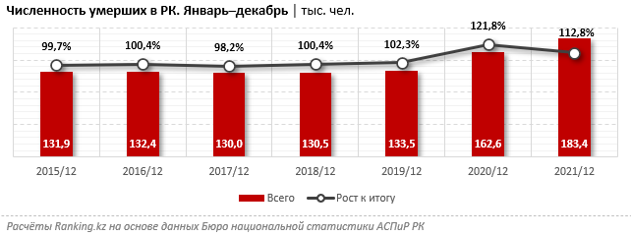
Kazakhstanis more likely to die from heart disease in 2021 - statistics
According to the diagram in 2021, the number of deaths in Kazakhstan amounted to 183.4 thousand people. This is 12.8% more than in 2020. If you pay attention to the growing trend, the number of cases is growing every year and it is worth paying particular attention to.

Slide 3
Current U.S. status on heart disease
According to the Centers for Disease Control and Prevention (CDC) approximately every 40 seconds an American will have a heart attack.
Every year, 805,000 Americans have a heart attack:
605,000 of them for the first time
200,000 happen to people who have already had a heart attack
About 1 in 5 heart attacks are silent—the damage is done, but the person is not aware of it.
About 697,000 people in the United States died from heart disease in 2020—that’s 1 in every 5 deaths.

Slide 4
About Dataset
The dataset come from the CDC and is a major part of the Behavioral Risk Factor Surveillance System (BRFSS), which conducts annual telephone surveys to gather data on the health status of U.S. residents. As the CDC describes: "Established in 1984 with 15 states, BRFSS now collects data in all 50 states as well as the District of Columbia and three U.S. territories. BRFSS completes more than 400,000 adult interviews each year, making it the largest continuously conducted health survey system in the world.". The most recent dataset (as of September 15, 2022) includes data from 2021. It consists of 438,693 rows and 303 columns. The vast majority of columns are questions asked to respondents about their health status, such as "Do you have serious difficulty walking or climbing stairs?" or "Have you smoked at least 100 cigarettes in your entire life? etc.

Slide 5
What can I do with the data from CDC?
Apply a number of different machine learning classifier techniques as well as artificial intelligence models to classify the respondent's current situation regarding heart disease.
If we can rely on the results of the classifier model, then we can use different
(not time-consuming) methods of obtaining data about the respondent's health status to classify them and reduce the time to search for people with heart disease.

